Slide 1
Multi-omics Boot Camp
Analysis of Omics Data for Research Studies
Bringing it all together: Multi-omic Analysis in Real Data

Slide 2
Overview
Goal: Illustrate multi-omics data analysis approaches applied to real data.
Background:
Data: HELIX data
Exposure: Perfluorononanoic acid (PFNA)
Outcome: Liver Injury
Omics: 5 omics layers
Analysis: Examine whether multi-omics data mediates the association between exposures and outcomes using:
Mediation without dimensionality reduction
Mediation with dimensionality reduction/clustering

Slide 3
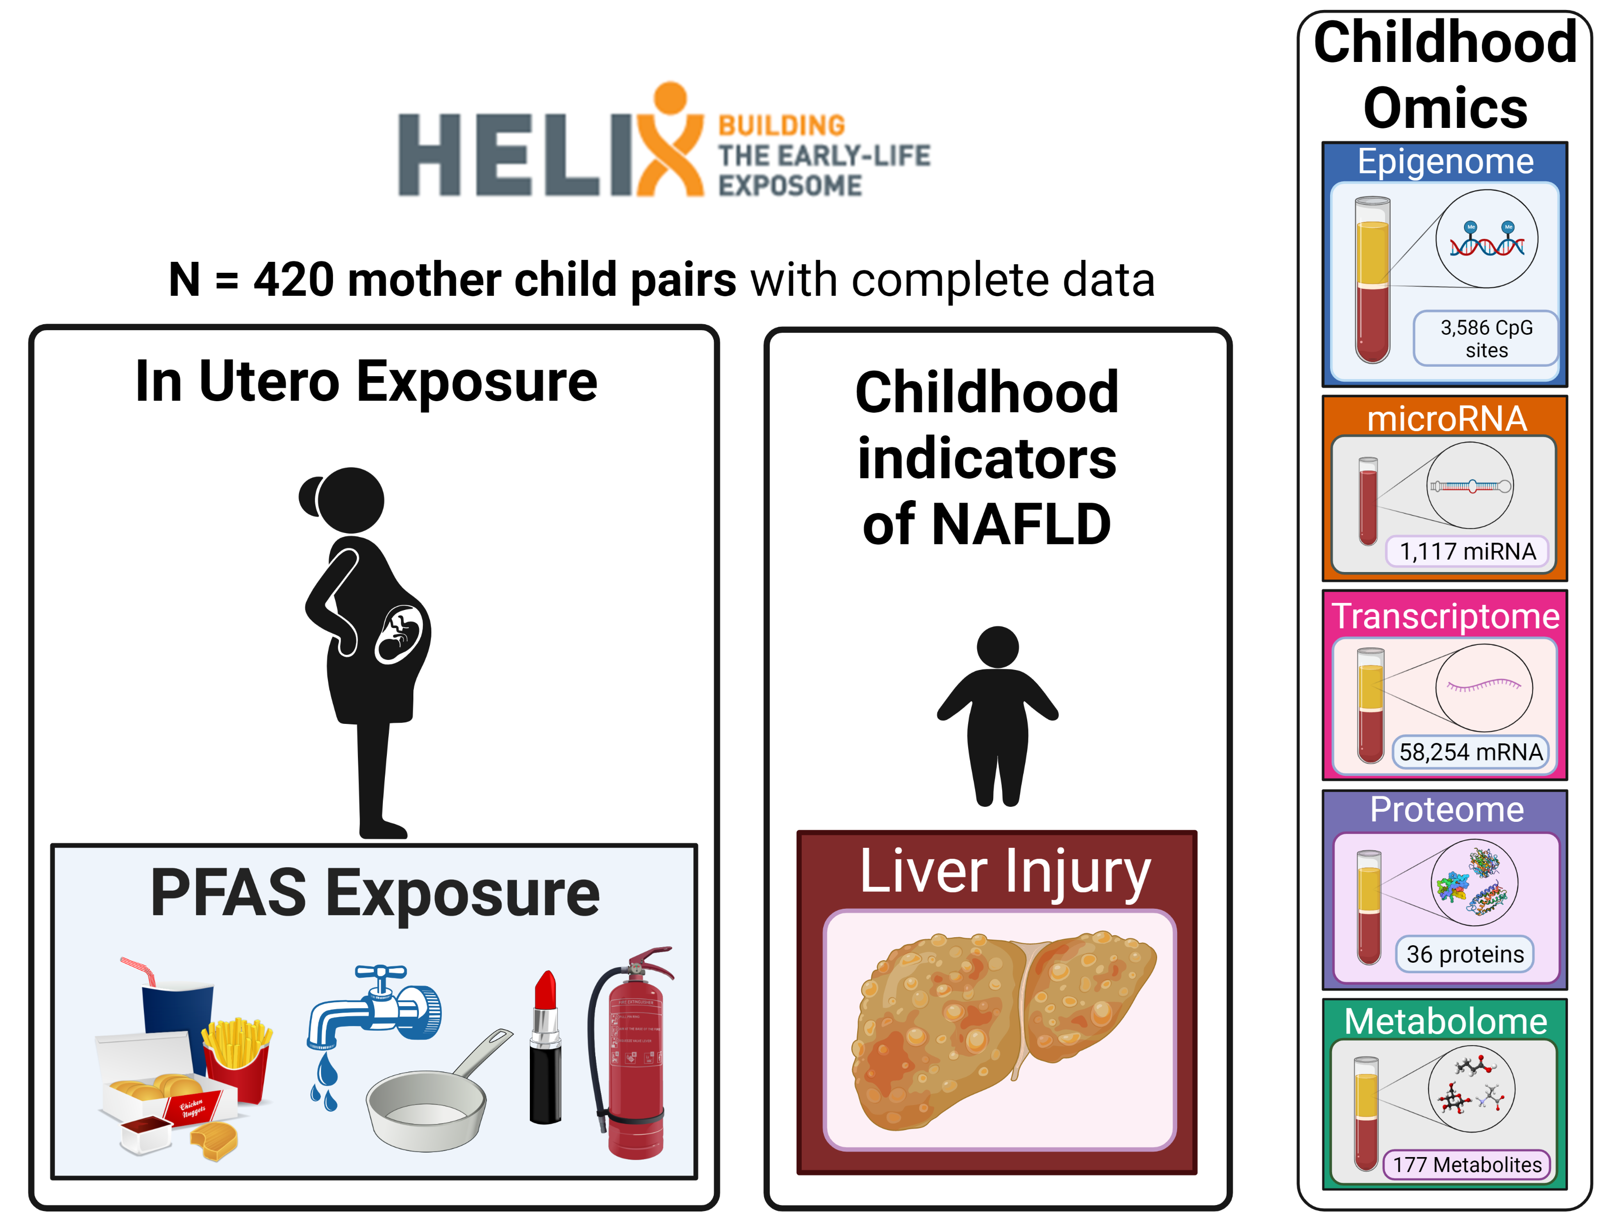

Slide 4
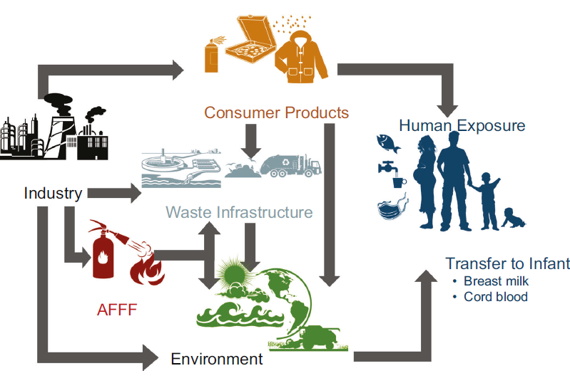
What are PFAS?
How are we exposed?
“Forever chemicals”
Widely used in consumer products and industrial applications
Resistant to degradation
Detected in blood of almost everyone
Exhibit metabolic and endocrine disrupting properties
Sunderland et al., J Expos Sci & Epidemiol, 2019
Notes:
PFAS have been widely used in a variety of industrial applications and consumer products including water repellant textiles, nonstick coatings, and food packaging products. Due to their high stability and low surface are very resistant to degradation, thus they are very persistent in the environment and the human body. That is why recent human biomonitoring studies show widespread exposure as they can detected in blood of almost everyone in the US.

Slide 5
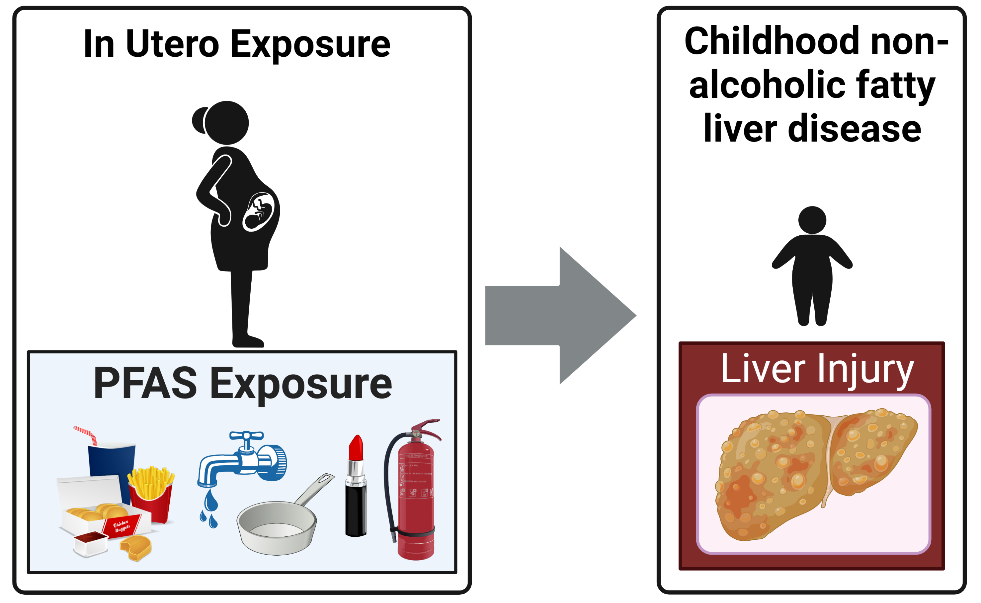
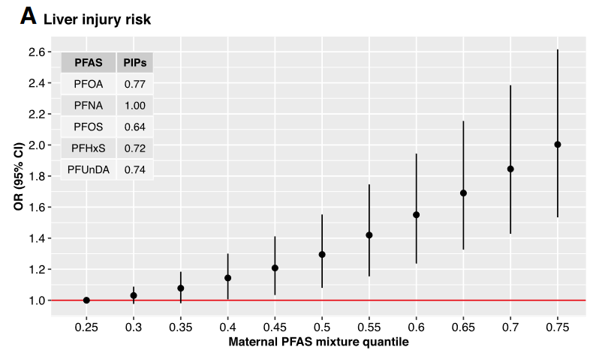

PFAS are hepatotoxic
Stratakis, Conti, et al., Hepatology, 2020

Slide 6
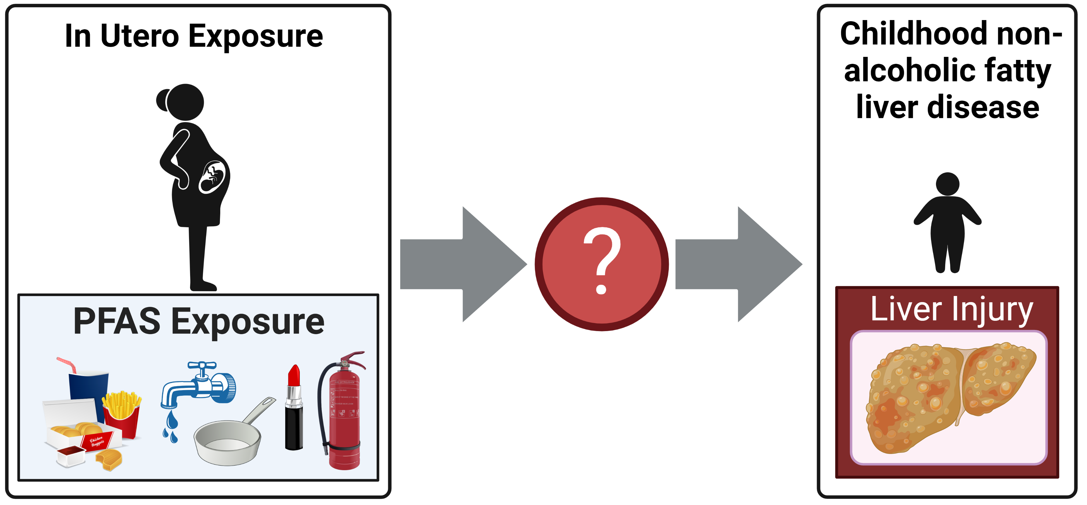
However, the mechanisms are not clear

Slide 7
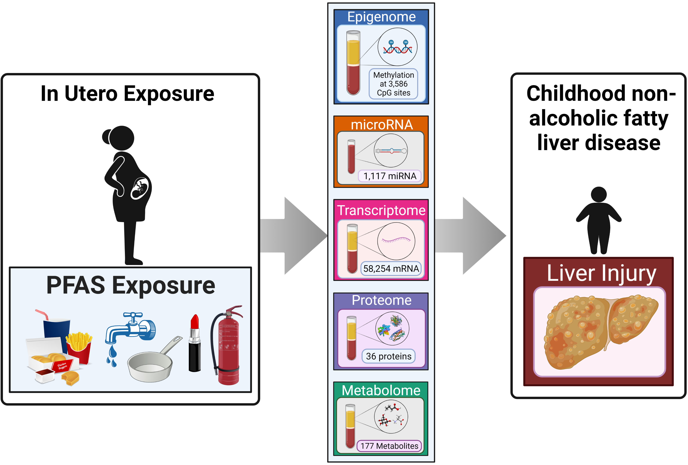
Goal: Integrate multi-omics data to understand mechanisms linking PFAS & liver injury

Slide 8
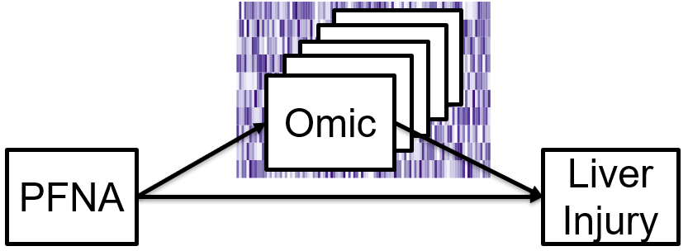
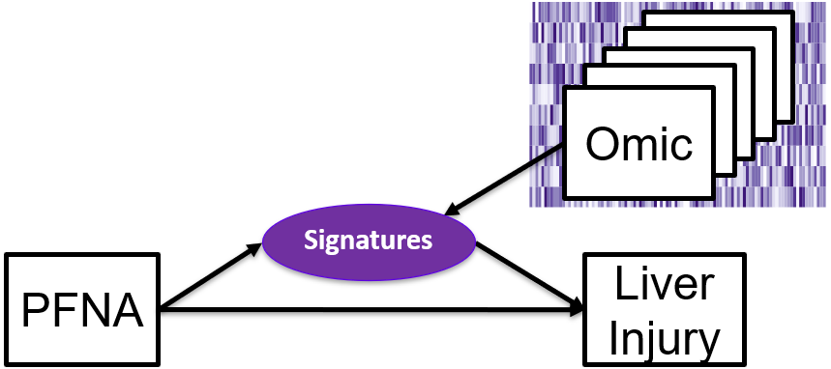
Approaches: Mediation with Multi-omics
Part 1: High Dimensional Mediation Analysis
Part 2: Mediation with Multi-omics signatures: dimensionality reduction and clustering

Slide 9
Overview: Mediation with Multi-omics
Part 1: High Dimensional Mediation Analysis
Early integration
Late integration
Part 2: Mediation with Multi-omics signatures
Dimensionality Reduction
PCA (early and late integration)
JIVE (intermediate integration)
Clustering
K-means (early and late integration)
intNMF (intermediate integration)

Slide 10
Overview: Mediation with Multi-omics
Part 1: High Dimensional Mediation Analysis
Early integration
Late integration
Part 2: Mediation with Multi-omics signatures
Dimensionality Reduction
PCA (early and late integration)
JIVE (intermediate integration)
Clustering
K-means (early and late integration)
intNMF (intermediate integration)

Slide 11
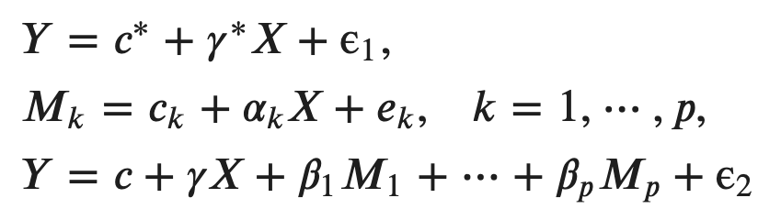
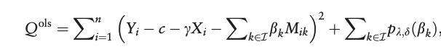
Part 1: High Dimensional Mediation
Model:
Step 1: screening so that p < n
Step 2: maximize penalized loss:
R package HIMA (Zhang et al., Bioinformatics, 2021)

Slide 12
Part 1: High Dimensional Mediation
High dimensional mediation model, implemented in R package HIMA (Zhang et al., Bioinformatics, 2021)
Early Integration:
Concatenate all 5 omics layers prior to analysis
Late Integration:
Analyze all 5 omics layers seperately, combine results after analysis

Slide 13
Part 1: High Dimensional Mediation
High dimensional mediation model, implemented in R package HIMA (Zhang et al., Bioinformatics, 2021)
Approach A: Early Integration
Concatenate all 5 omics layers prior to analysis
Approach B: Late Integration
Analyze all 5 omics layers seperately, combine results after analysis

Slide 14
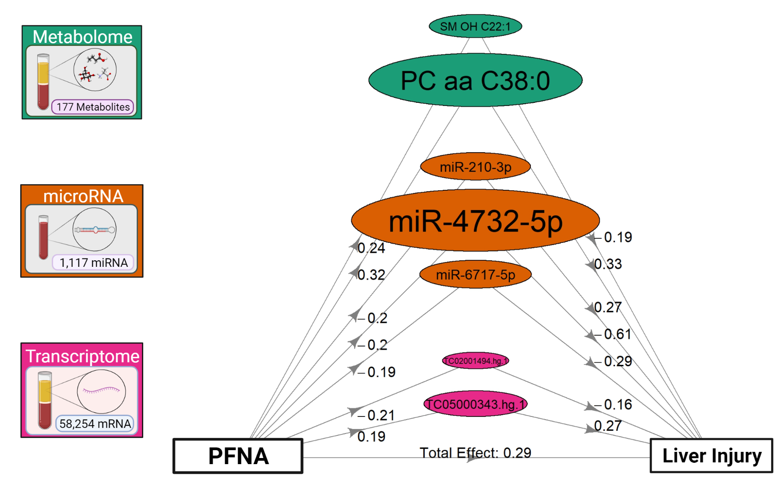
1.A. HIMA, Early Integration: Results
Oval size is proportional to the percent of the total effect for the given mediator
All mediation pathways are significant based on an FDR adjusted p-value < 0.05
Effects are conditional on each other
Notes:
These effects are conditional on each other

Slide 15
Part 1: High Dimensional Mediation
High dimensional mediation model, implemented in R package HIMA (Zhang et al., Bioinformatics, 2021)
Approach A: Early Integration
Concatenate all 5 omics layers prior to analysis
Approach B: Late Integration
Analyze all 5 omics layers seperately, combine results after analysis

Slide 16
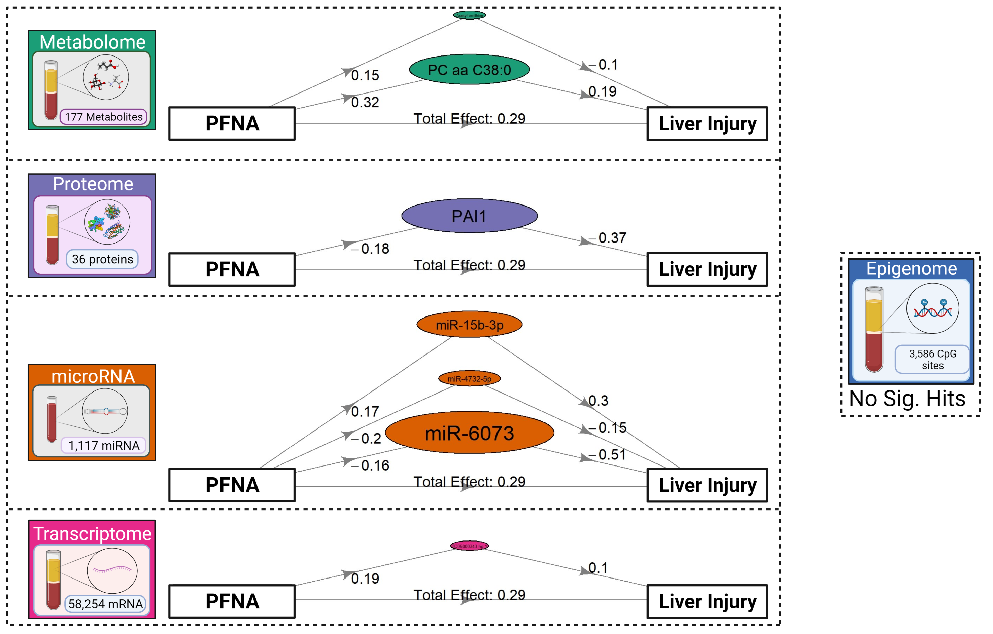
1.B. HIMA, Late Integration: Results
Notes:
Oval size proportional to the percent of the total effect for the given mediator
All pathways are significant based on an FDR threshold of 0.05

Slide 17
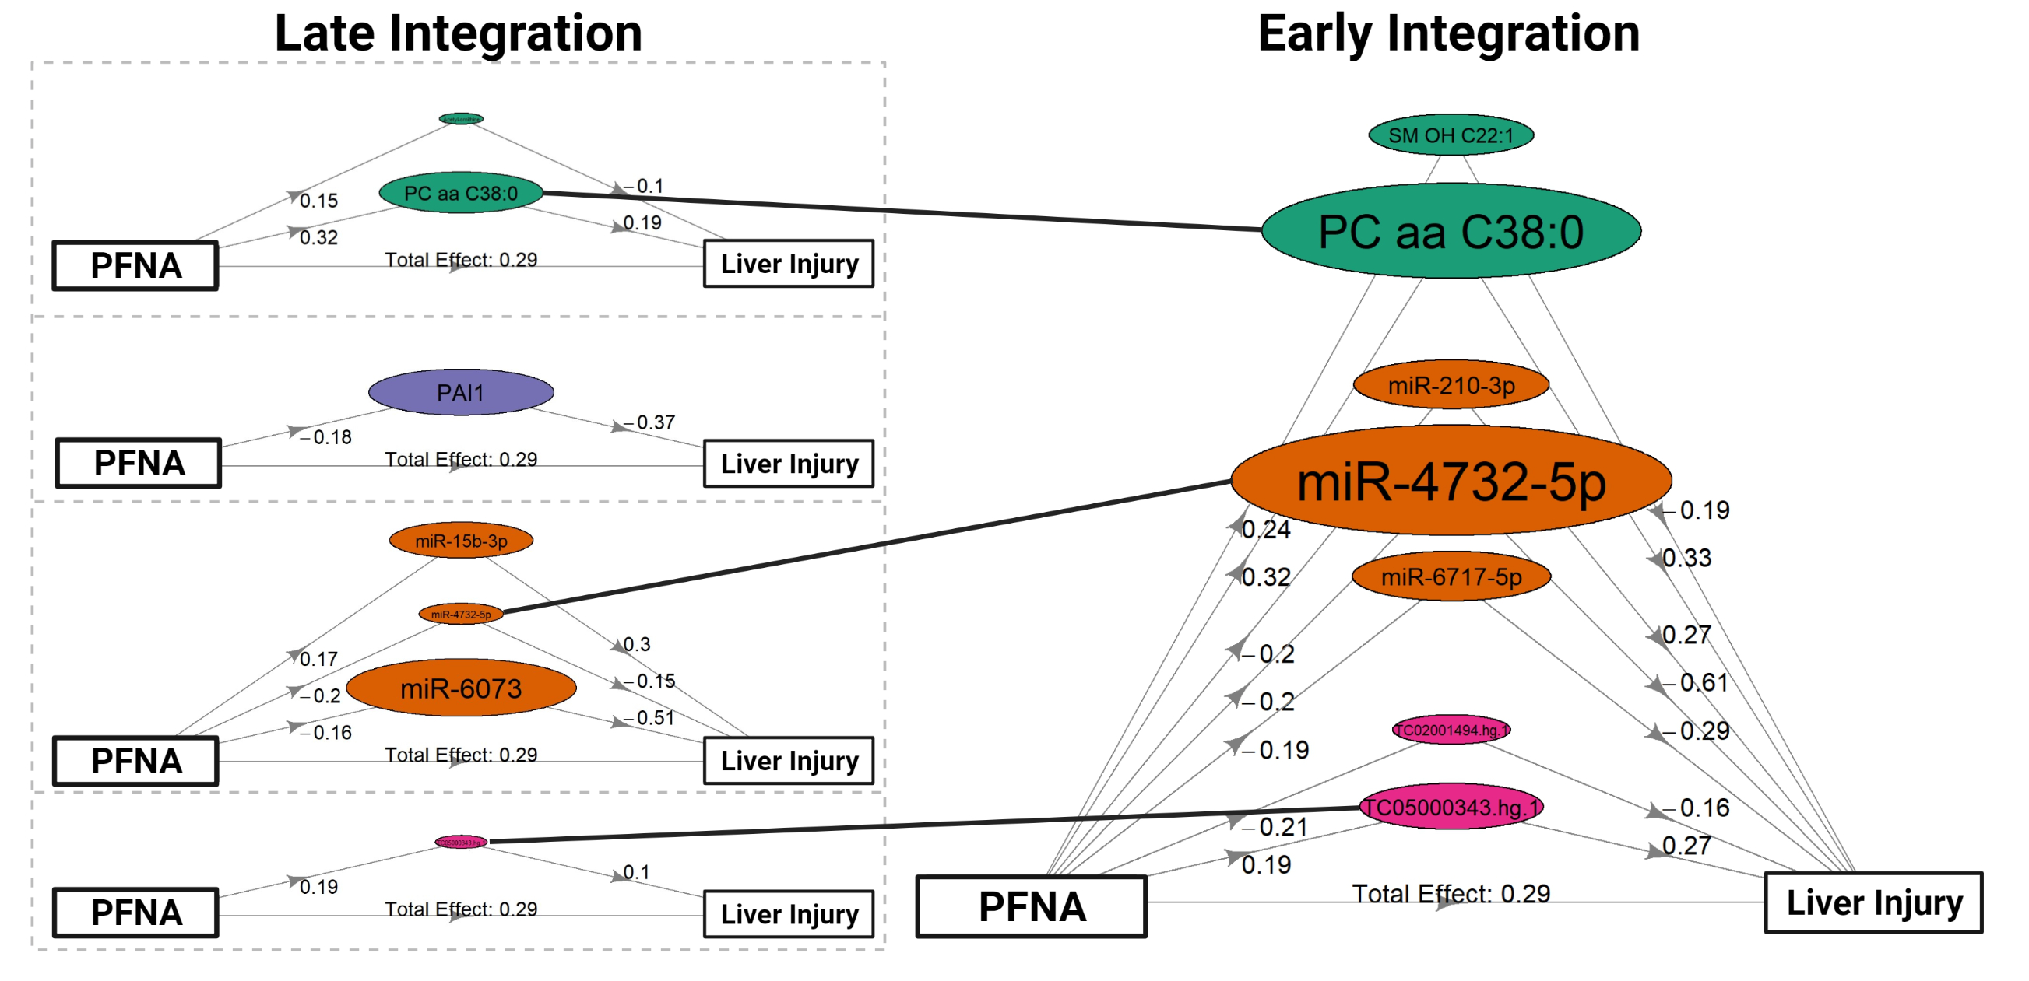
HIMA, Early vs. Late Integration

Slide 18
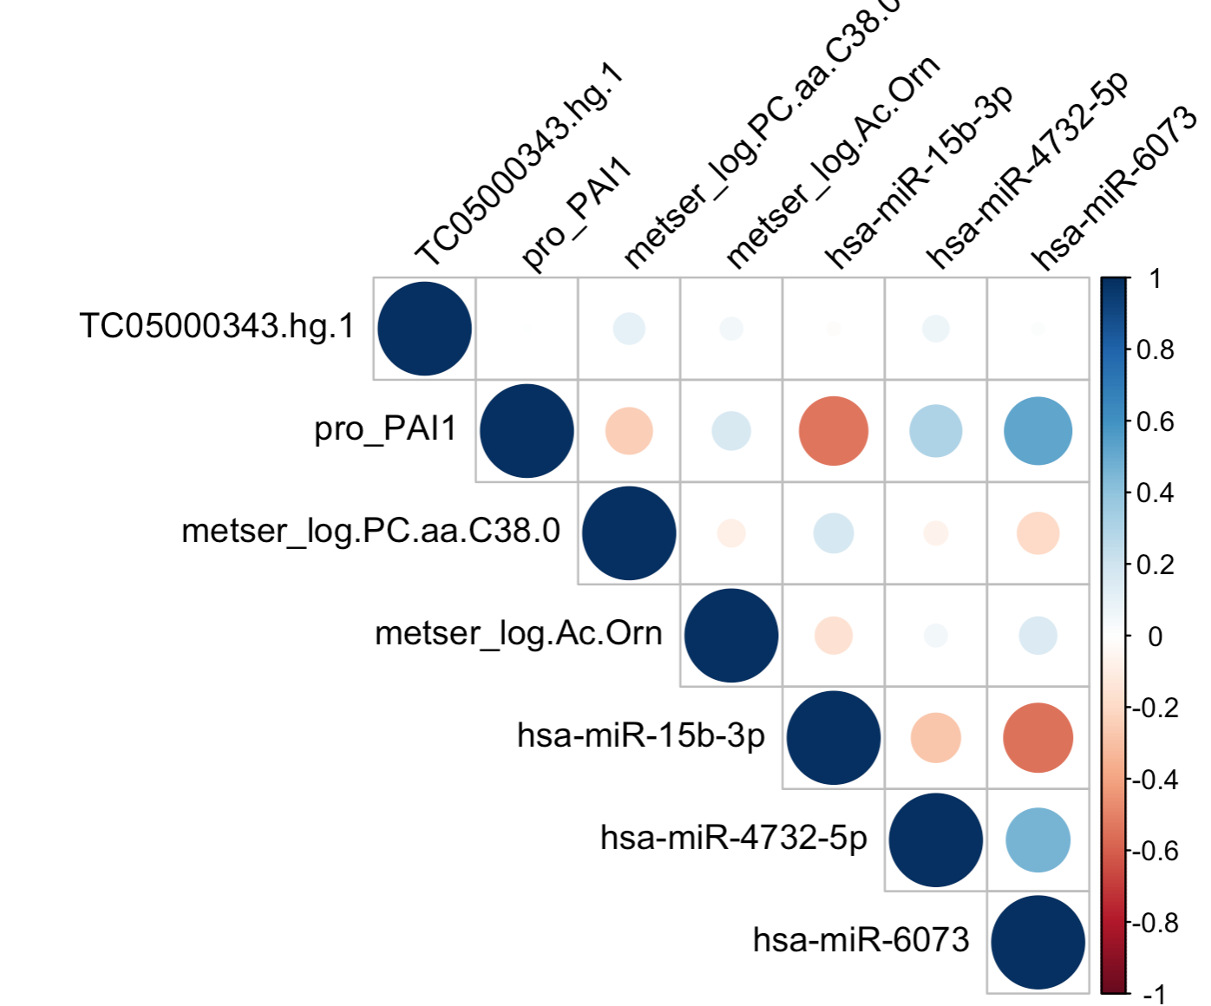
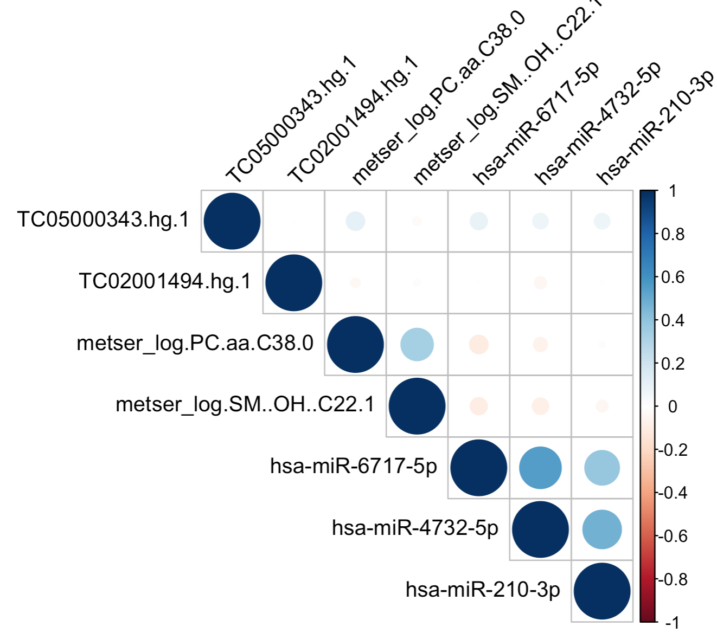
HIMA, Early vs. Late Integration
Late Integration (all omics seperately)
Early Integration (concatenate omics)

Slide 19
Summary: High Dimensional Mediation
HIMA with Late integration selects features without accounting for correlation structures across omics layers
HIMA with Early integration accounts for correlations between all features, and selected features are relatively independent
Depending on the context, both approaches could be useful

Slide 20
Overview: Mediation with Multi-omics
Part 1: High Dimensional Mediation Analysis
Early integration
Late integration
Part 2: Mediation with Multi-omics signatures
Dimensionality Reduction
PCA (early and late integration)
JIVE (intermediate integration)
Clustering
K-means (early and late integration)
intNMF (intermediate integration)

Slide 21
Part 2. Mediation with dimensionality reduction/clustering
Dimensionality Reduction
Reduce high dimensional omics to a low dimensional space
Use the resulting factors as mediators using HIMA
Clustering based on omics profiles
Identify clusters of individuals with similar omics profiles
Use clusters as a latent mediator, using HIMA/ traditional mediation

Slide 22
Part 2. Mediation with dimensionality reduction/clustering
Dimensionality Reduction, then HIMA
Early Integration (PCA)
Late Integration (PCA)
Intermediate Integration (JIVE)
Clustering based on omics profiles, then mediation
Early Integration (K-means)
Late Integration (K-means)
Intermediate integration (intNMF)

Slide 23
Part 2. Mediation with dimensionality reduction/clustering
Dimensionality Reduction, then HIMA
Early Integration (PCA)
Late Integration (PCA)
Intermediate Integration (JIVE)
Clustering based on omics profiles, then mediation
Early Integration (K-means)
Late Integration (K-means)
Intermediate integration (intNMF)

Slide 24

2.A. Dimensionality Reduction, Early Integration
Epigenome
miRNA
Transcriptome
Proteome
Metabolome
Principle Components
PFNA
Liver Injury
Mediation tested using HIMA

Slide 25
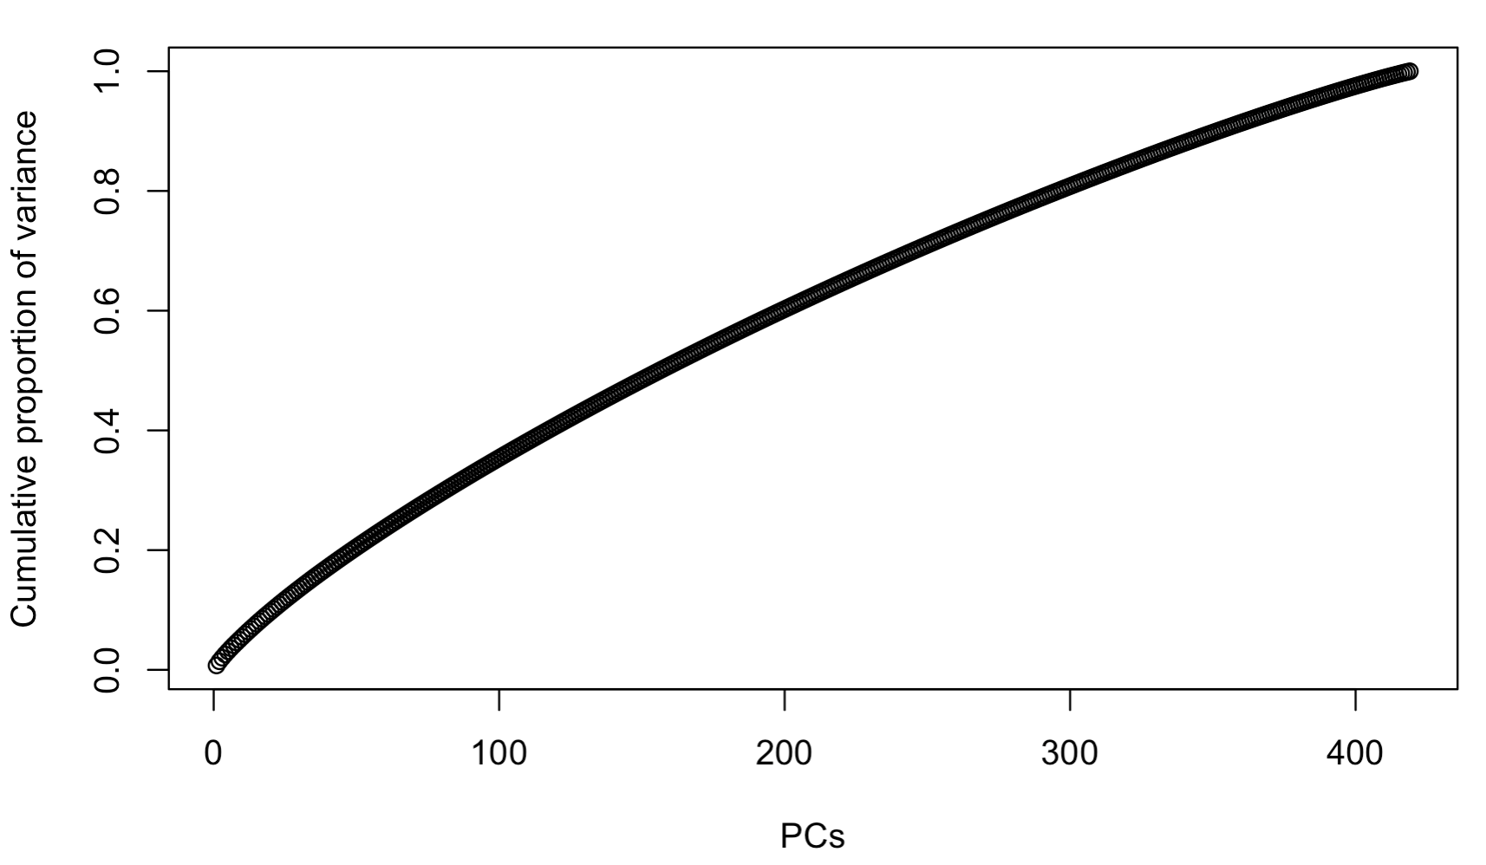
2.A. Dimensionality Reduction, Early Integration:
Results
Original data: 63,170 features
First 296 Principal components explain >80% of total variance
No Significant findings from HIMA

Slide 26
Part 2. Mediation with dimensionality reduction/clustering
Dimensionality Reduction, then HIMA
Early Integration (PCA)
Late Integration (PCA)
Intermediate Integration (JIVE)
Clustering based on omics profiles, then mediation
Early Integration (K-means)
Late Integration (K-means)
Intermediate integration (intNMF)

Slide 27
2.A. Dimensionality Reduction, Late Integration
Epigenome
PCs
PFNA
Liver Injury
miRNA
PCs
PFNA
Liver Injury
Metabolome
Combine Results
PCs
PFNA
Liver Injury
Transcriptome
PCs
PFNA
Liver Injury
Proteome
PCs
PFNA
Liver Injury
Mediation tested using HIMA
27

Slide 28
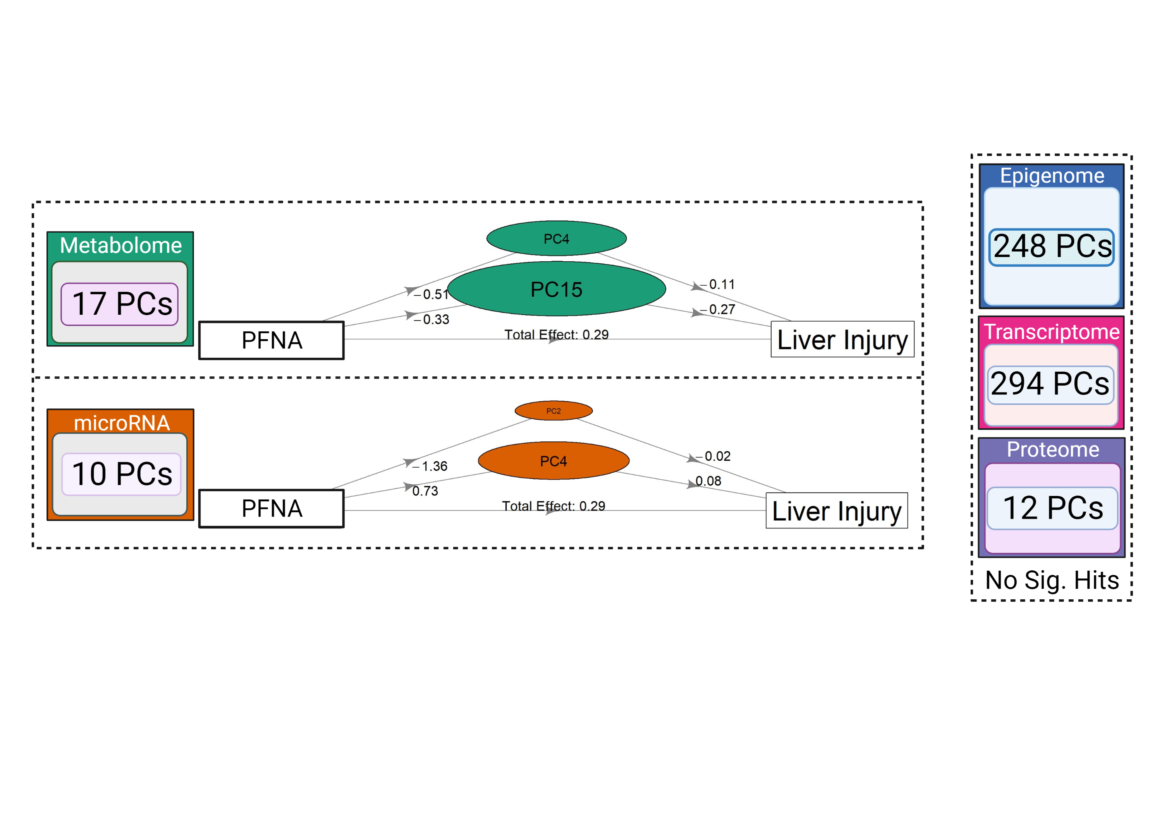
2.A. Dimensionality Reduction, Late Integration:
Results

Slide 29
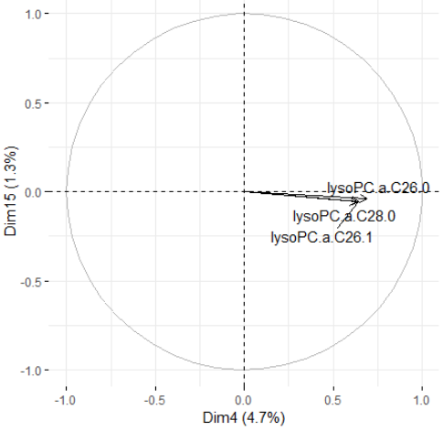
2.A. Dimensionality Reduction, Late Integration:
Results
Top 3 metabolites in PC4 and PC15 are all glycerophosphocholines (a class of lipids)
Top 3 metabolites contributions to PC4 and PC15

Slide 30
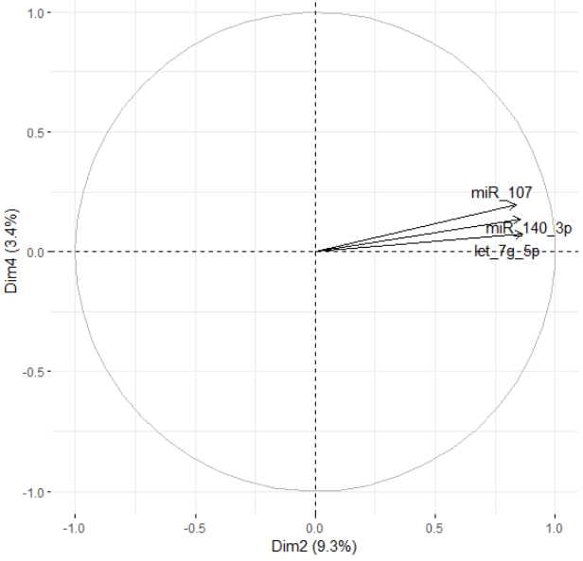
2.A. Dimensionality Reduction, Late Integration:
Results
Top 3 miRNA contributions to PC2 and PC4

Slide 31
Part 2. Mediation with dimensionality reduction/clustering
Dimensionality Reduction, then HIMA
Early Integration (PCA)
Late Integration (PCA)
Intermediate Integration (JIVE)
Clustering based on omics profiles, then mediation
Early Integration (K-means)
Late Integration (K-means)
Intermediate integration (intNMF)

Slide 32
2.A. Dimensionality Reduction, Intermediate Integration
Epigenome
miRNA
Transcriptome
Proteome
Metabolome
JIVE
Factors
PFNA
Liver Injury
Mediation tested using HIMA
32

Slide 33
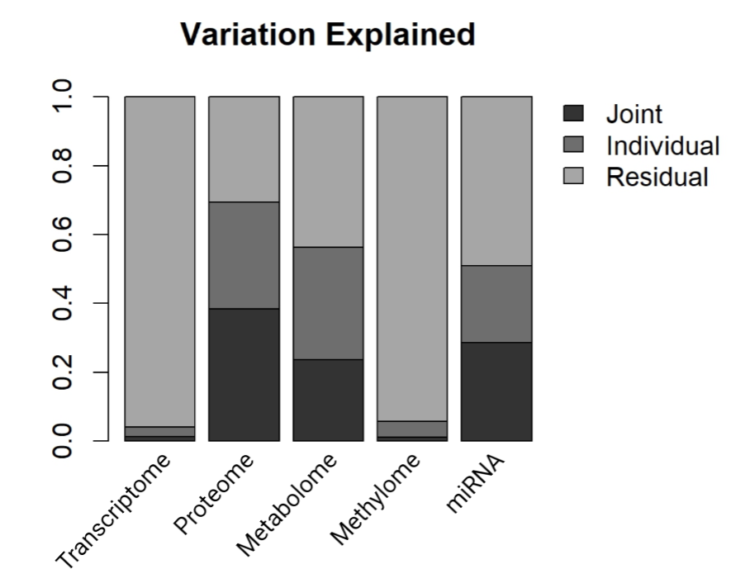
2.A. Dimensionality Reduction, Intermediate Integration:
JIVE Results
Joint dimension reduction: Joint and Individual Variation Explained (JIVE) decomposition
Returns matrices that capture joint (across omics) and individual (within omics) structure of the data
For this analysis, used 5 factors
33

Slide 34
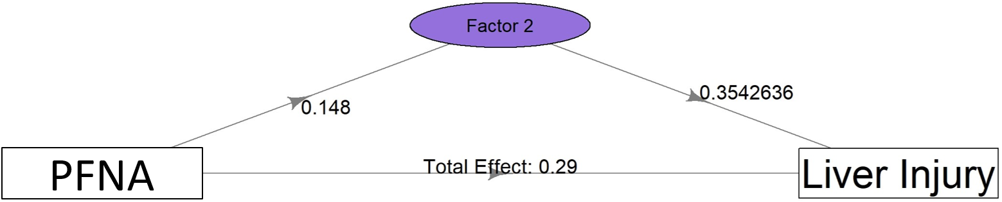
2.A. Dimensionality Reduction, Intermediate Integration:
JIVE Factors as Mediators
34

Slide 35
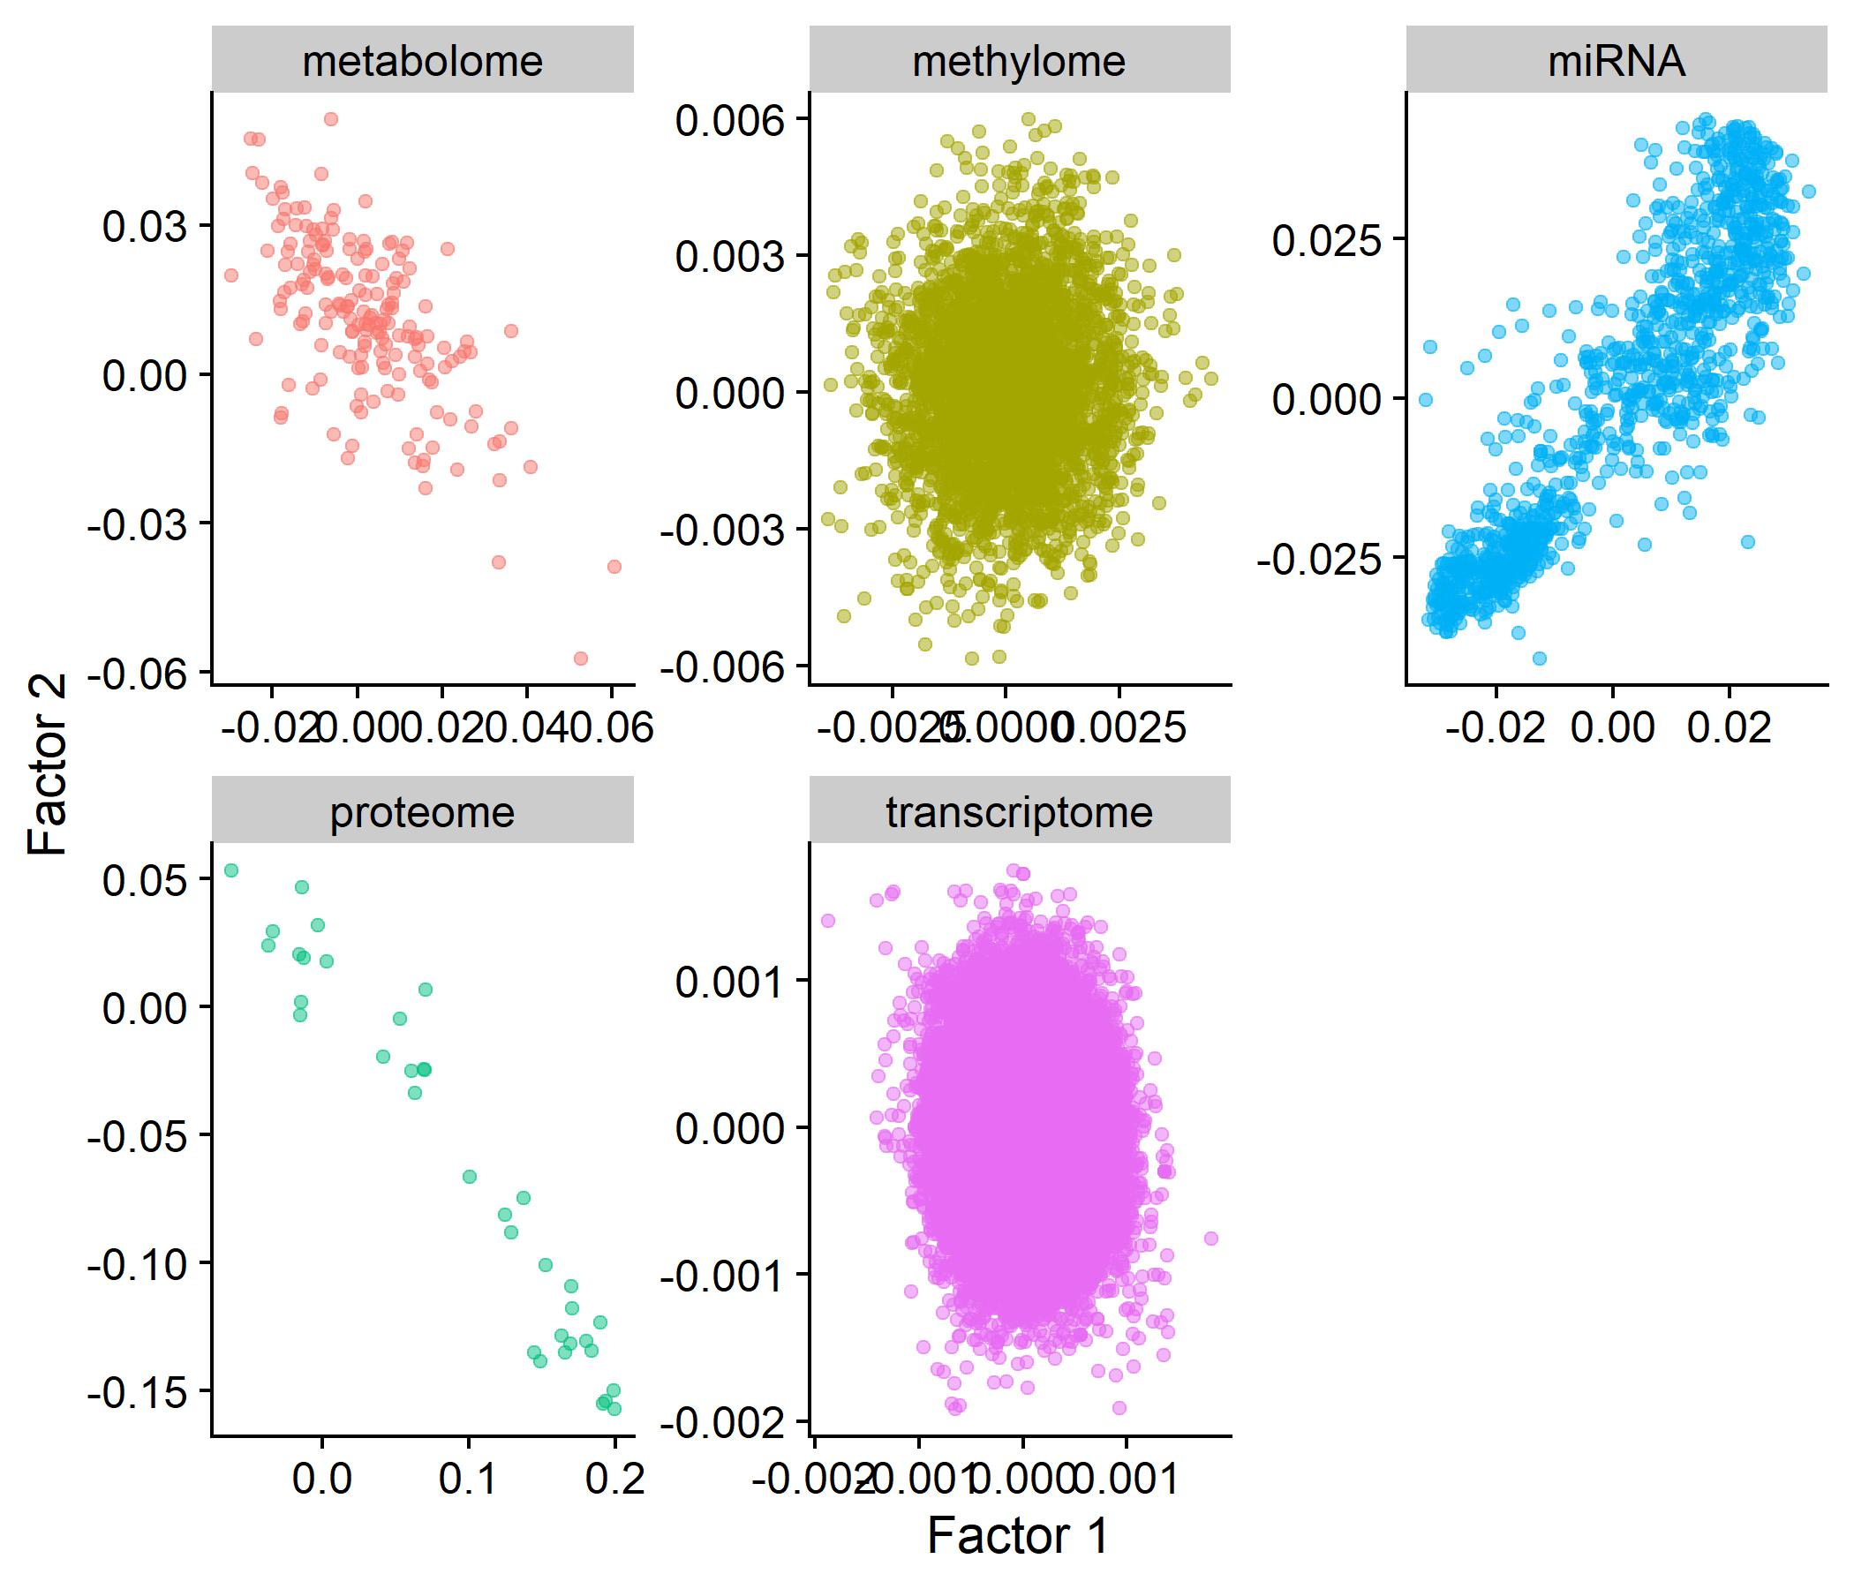
2.A. Dimensionality Reduction, Intermediate Integration:
JIVE Results
Loadings for individual features on JIVE factors 1 and 2
35

Slide 36
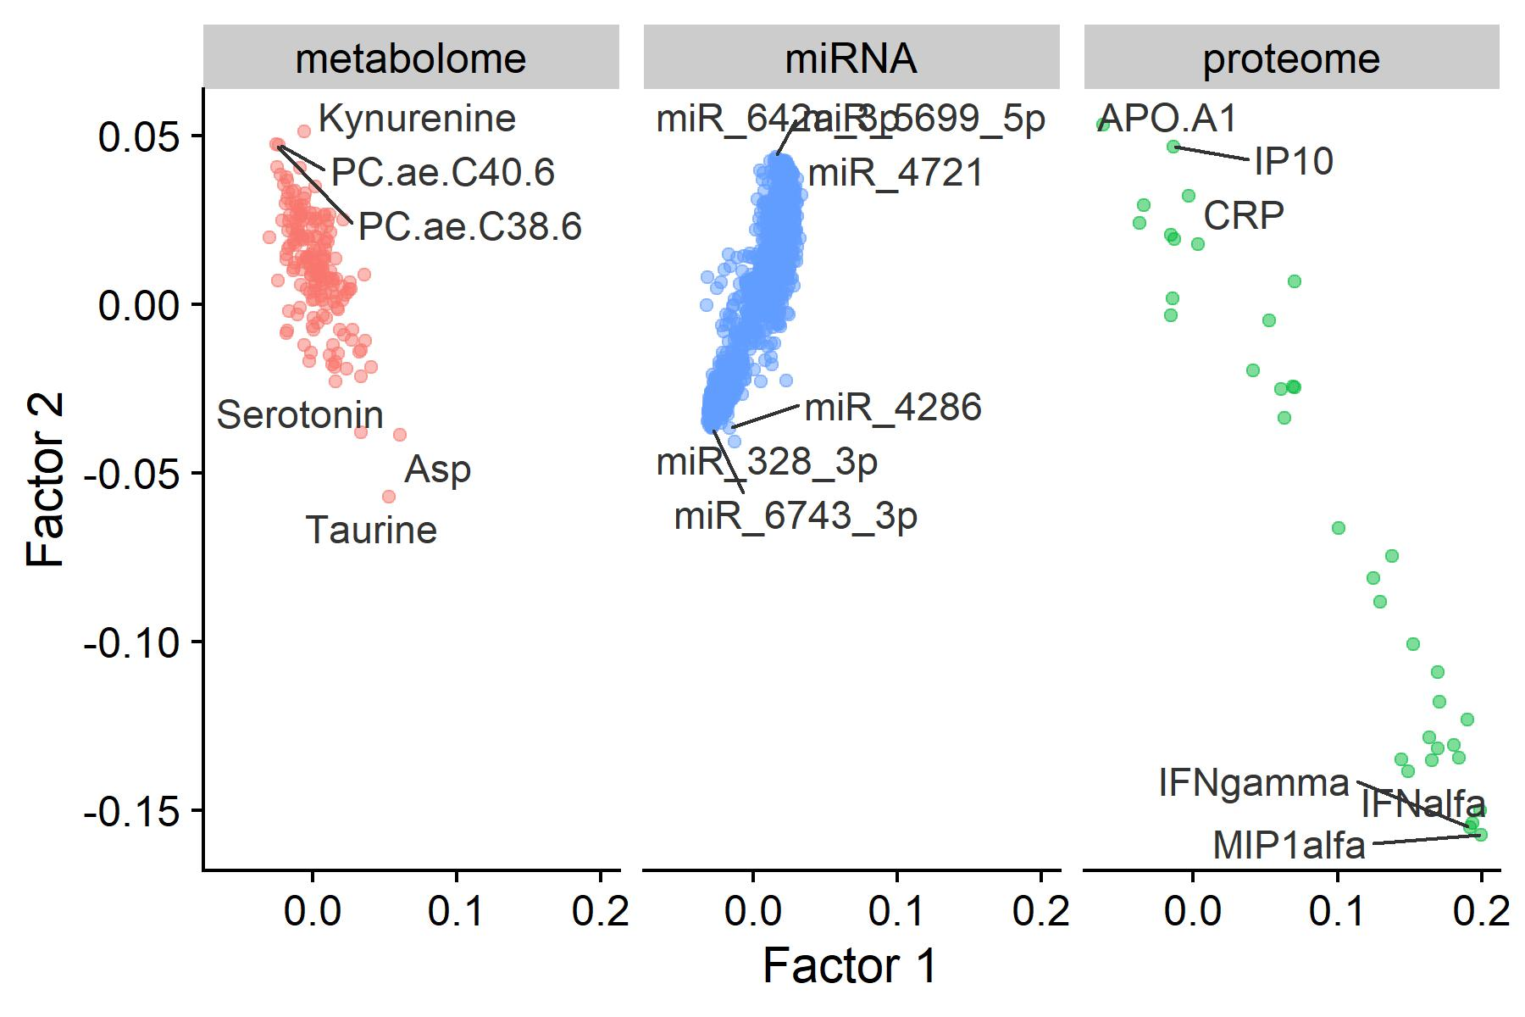
2.A. Dimensionality Reduction, Intermediate Integration:
JIVE, Factors 1 and 2
36

Slide 37
Part 2. Mediation with dimensionality reduction/clustering
Dimensionality Reduction, then HIMA
Early Integration (PCA)
Late Integration (PCA)
Intermediate Integration (JIVE)
Clustering based on omics profiles, then mediation
Early Integration (K-means)
Late Integration (K-means)
Intermediate integration (intNMF)

Slide 38
2.B. Early Integration, K-means
Epigenome
miRNA
Transcriptome
Proteome
Metabolome
Clusters
PFNA
Liver Injury
Mediation tested via r package mediate

Slide 39
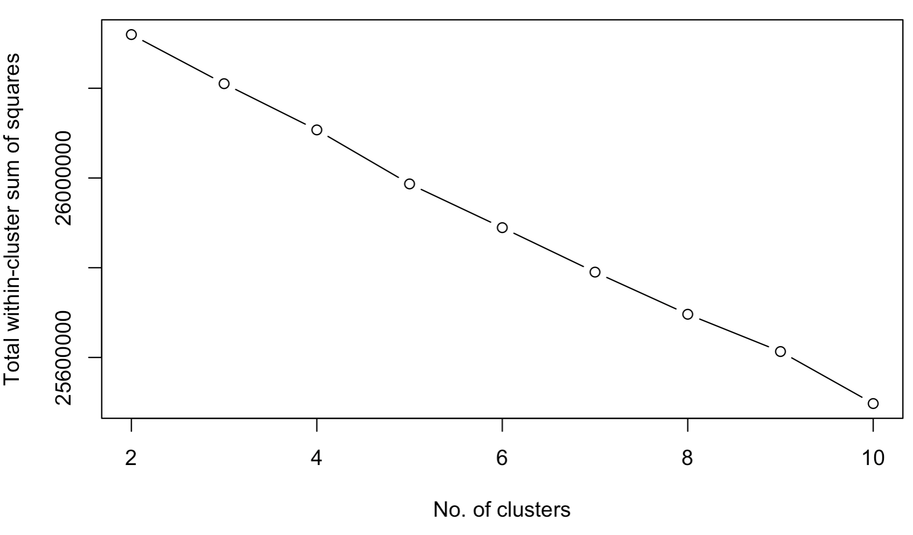
2.B. Early Integration, K-means:
Results
K-means does not work well for this data
No clear number of clusters, so we did not test mediation

Slide 40
Part 2. Mediation with dimensionality reduction/clustering
Dimensionality Reduction, then HIMA
Early Integration (PCA)
Late Integration (PCA)
Intermediate Integration (JIVE)
Clustering based on omics profiles, then mediation
Early Integration (K-means)
Late Integration (K-means)
Intermediate integration (intNMF)

Slide 41
2.B. Late Integration, K-means
Epigenome
Cluster
miRNA
Cluster
Metabolome
Cluster
Transcriptome
Cluster
Proteome
Cluster
PFNA
Liver Injury
Mediation tested using HIMA
41
Notes:
Mediation performed via HIMA
Performed K-means within each omics layer
Used 2 clusters
Use cluster assignments from all omics layers as mediators for HIMA

Slide 42
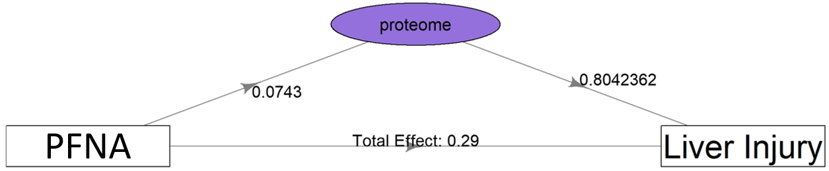
2.B. Late Integration, K-means:
Results

Slide 43
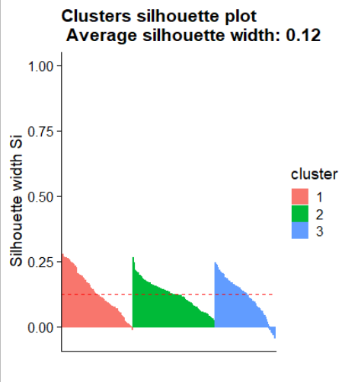
2.B. Late Integration, K-means
Proteome cluster
K-means does not perform well with this data
Notes:
Silhouette score is used to evaluate the quality of clusters created using clustering algorithms in terms of how well samples are clustered with other samples that are similar to each other. Value ranges from -1 to 1, with higher scores representing more similarity

Slide 44
Part 2. Mediation with dimensionality reduction/clustering
Dimensionality Reduction, then HIMA
Early Integration (PCA)
Late Integration (PCA)
Intermediate Integration (JIVE)
Clustering based on omics profiles, then mediation
Early Integration (K-means)
Late Integration (K-means)
Intermediate integration (intNMF)

Slide 45
2.B. Intermediate Integration, IntNMF
Epigenome
miRNA
Transcriptome
Proteome
Metabolome
IntNMF
Clusters
PFNA
Liver Injury
Mediation tested using r package mediate
45
Notes:
Joint clustering based on non-negative matrix factorization
Data shifted and rescaled- all data must be greater than 0

Slide 46
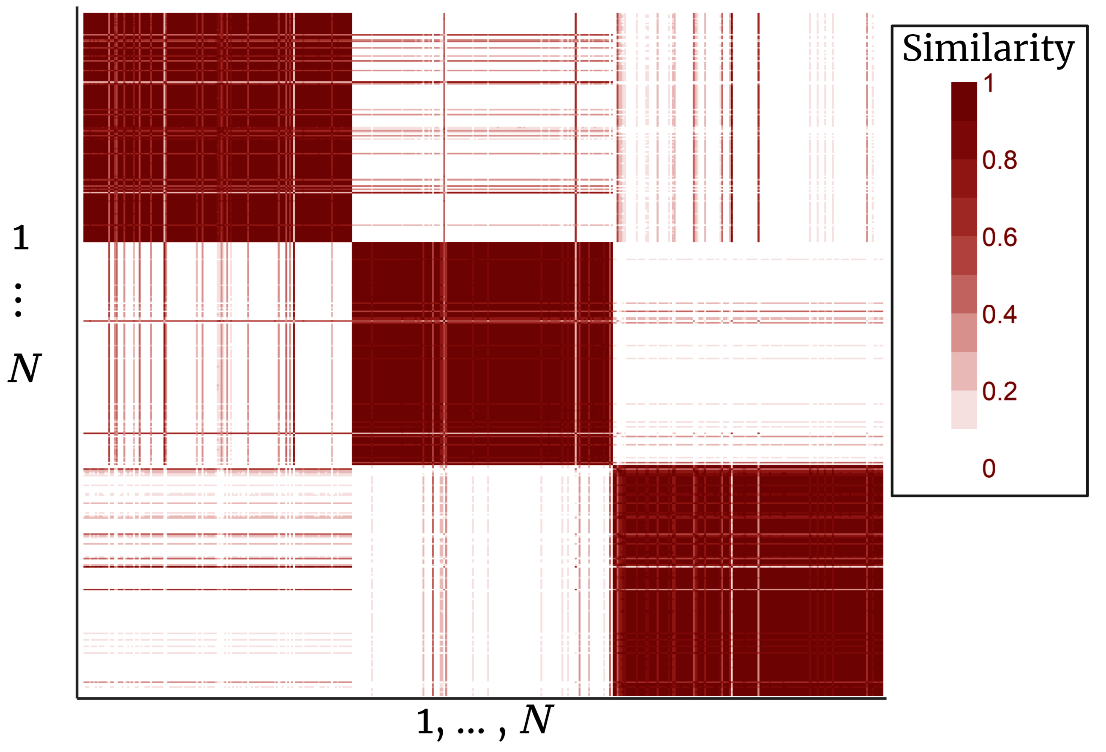
2.B. Intermediate Integration, IntNMF: Consensus Matrix
Consensus Matrix of IntNMF Results
Represents similarity between individuals
Three clear clusters
46

Slide 47
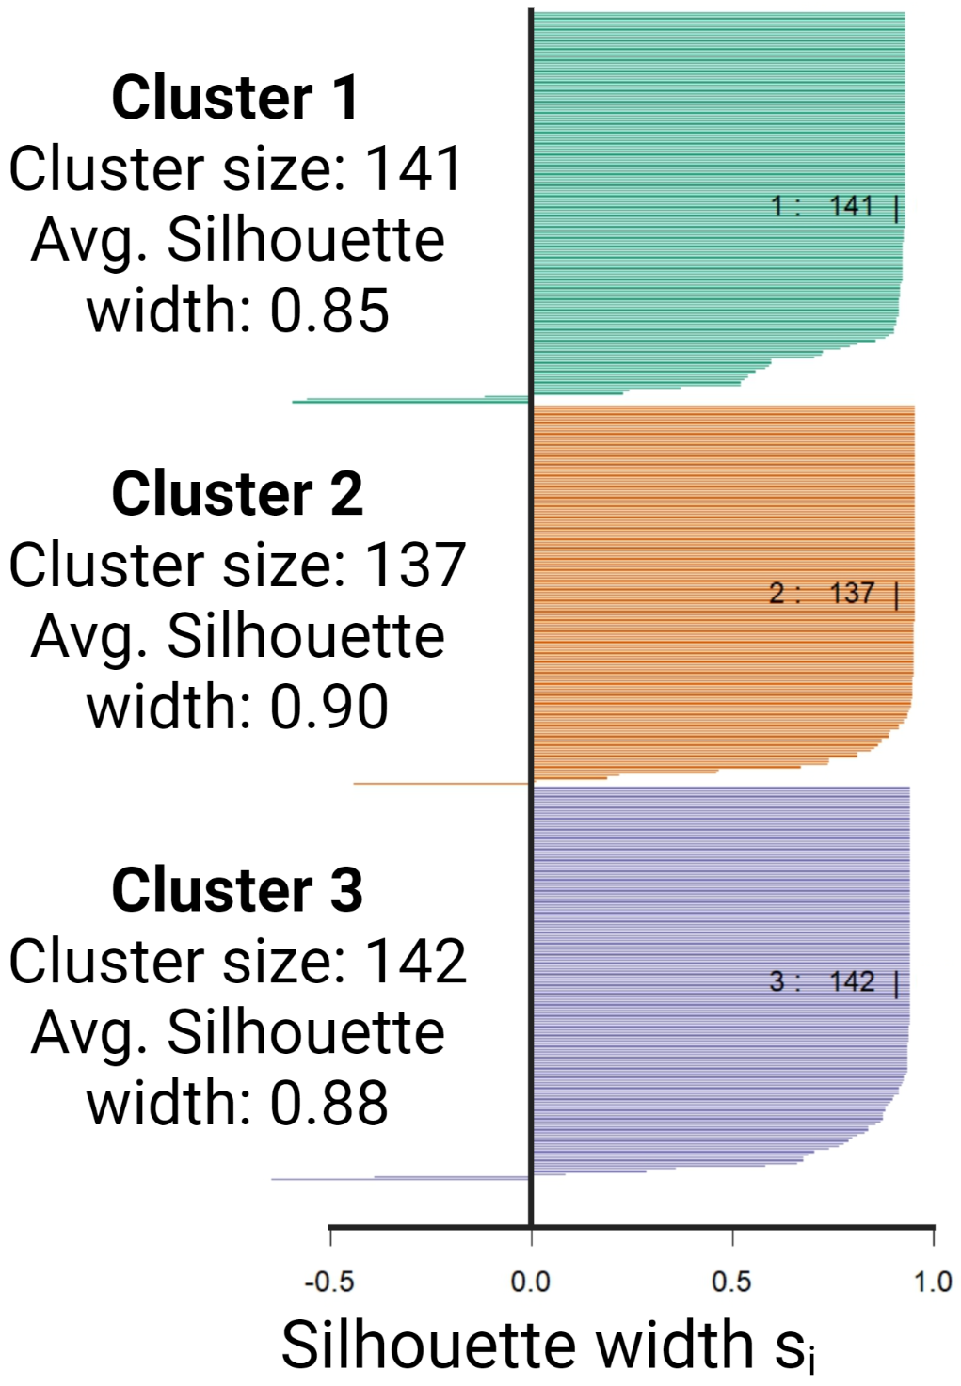
2.B. Intermediate Integration, IntNMF: Silhouette Plot
IntNMF does quite well at identifying clusters of individuals with similar multi-omic profiles
47

Slide 48
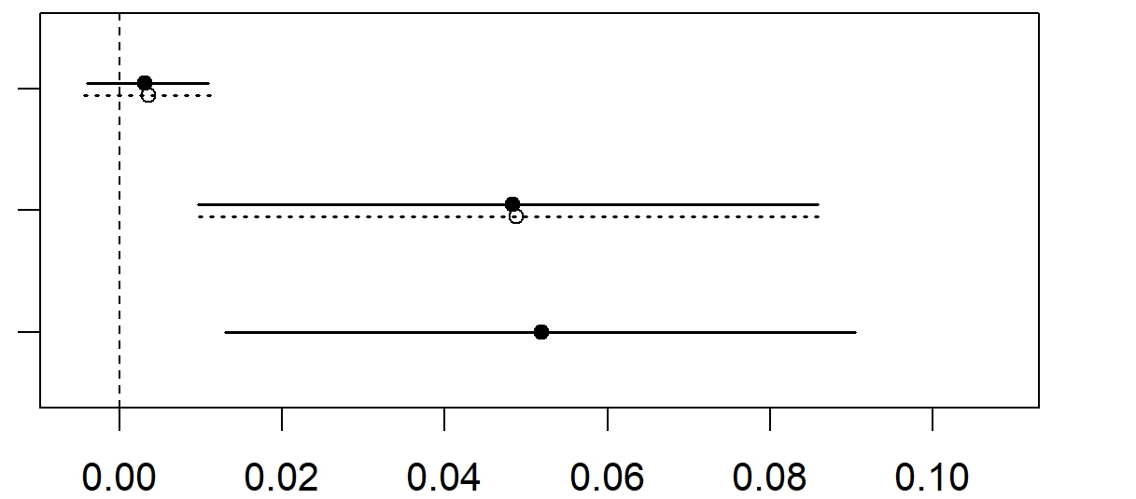
2.B. Intermediate Integration, IntNMF: Mediation Results
Mediation tested using r package mediate
Clusters identified by IntNMF do not mediate the association of in utero PFAS with childhood Liver Injury
Average Causal Mediated Effect
Average Direct Effect
Total Effect
48

Slide 49
Summary: Significant Mediating Effects with multiomic signatures
Dimensionality Reduction, then HIMA
Early Integration (PCA) → No Results
Late Integration (PCA) → Metabolome and miRNA PCs
Intermediate Integration (JIVE) → Joint factor, defined by metabolites, miRNA, and proteins
Clustering based on omics profiles, then mediation
Early Integration (K-means) → Poor algorithym performance
Late Integration (K-means) → Proteome Clusters (poor algorithym performance)
Intermediate integration (IntNMF) → Good performance, no significant mediating effects

Slide 50
Modeling omics jointly vs. independently
In joint models:
Condition out highly correlated variables, and only select features that are most “important” (defined by the algorithym).
Some significant “hits” might be correlated with “causal” variables in another layer
Good for feature selection
In independent models:
Fitting mediation model on each omics layer/ omics feature separately omits the correlation structure
Select all feature associated with the outcome
Good when you want to perform post hoc pathway analysis (i.e., biological interpretation)

Slide 51
Concluding Remarks
Many options for this analysis, but each tends to identify metabolites, miRNAs, and proteins as mediating factors.
Techniques specifically designed for multi-omics data work better at identifying robust multi-omics signatures (factors and/or clusters)
In practice, deciding on a data analysis approach or algorithym should be driven by your research question…
But in reality, real data is messy and different approaches may work better or worse in practice.
You could use these methods for interaction analysis instead of mediation

